Slide 1
Hidden Markov Model
隐马尔可夫模型

Slide 2
this presentation is modified from slides on the Internet
http://ufo.cs.ccu.edu.tw/bioinformatics/
以及Dorr等人的讲义

Slide 3
Markov property
In probability theory, a stochastic process has the Markov property if the conditional probability distribution of future states of the process, given the present state, depends only upon the current state, i.e. it is conditionally independent of the past states (the path of the process) given the present state.

Slide 4
Mathematically, if X(t), t > 0, is a stochastic process, the Markov property states that

Slide 5
Hidden Markov Models
Reference:
A Tutorial on Hidden Markov Models and Selected Applications in Speech Recognition, L. R. Rabiner, Proceedings of the IEEE, Vol. 77, No. 2, 1989

Slide 6
Outline
Introduction
Markov Models
Hidden Markov Models
Forward/Backward Algorithms
Viterbi Algorithm
Baum-Welch estimation algorithm

Slide 7
Introduction
Hidden Markov Model is a kind of stochastic processes which can describe natural phenomenon. It’s basic assumption is Markov property.
Stochastic Process: a probability model used to describe phenomena that evolve over time or space
    Bernoulli process, Chinese restaurant process, Markov process, hidden Markov model

Slide 8
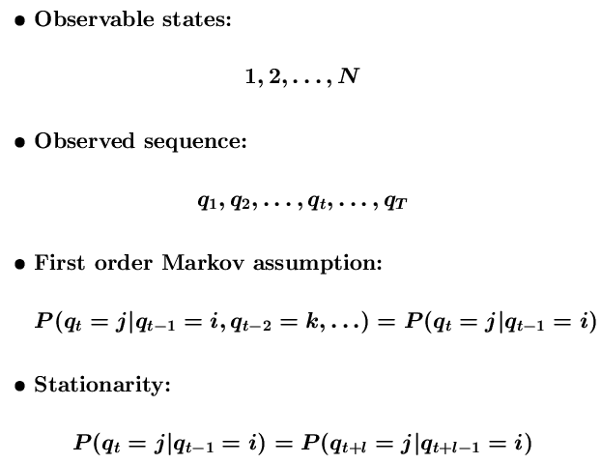
Markov Models

Slide 9
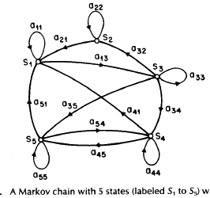
Markov Models can be described by state transition graph 状态转换图
States are observable

Slide 10
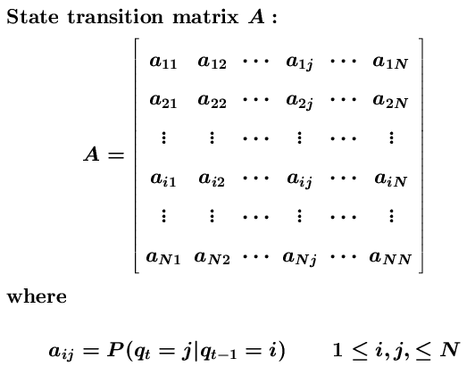

Markov Models

Slide 11
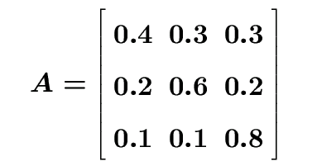
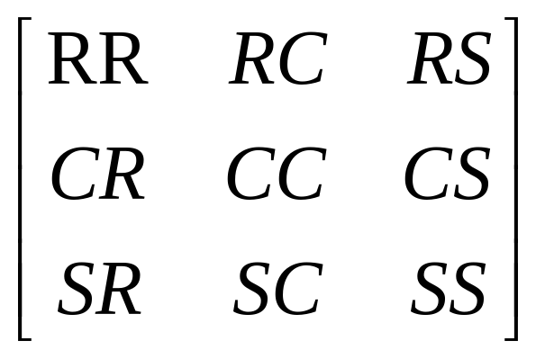
Weather Model
States
  R: Rainy, C: Cloudy, S: Sunny
State Transition Probability Matrix
What is the probability of observing O=SSRRSCS given that today is S?

Slide 12
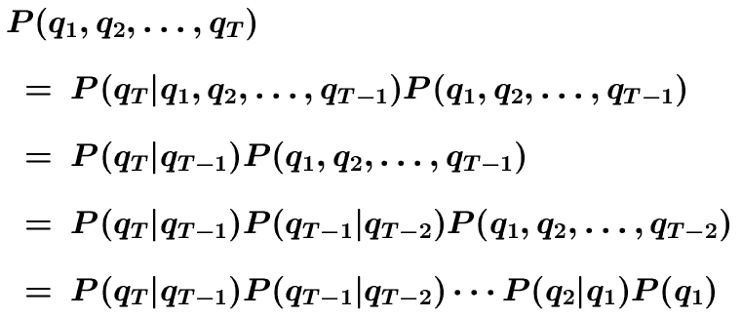
Weather Model
Basic Rule: P(A, B) = P(A|B)P(B)
Markov chain rule:
initial probability
π_{i} = P(q₁=i)

Slide 13
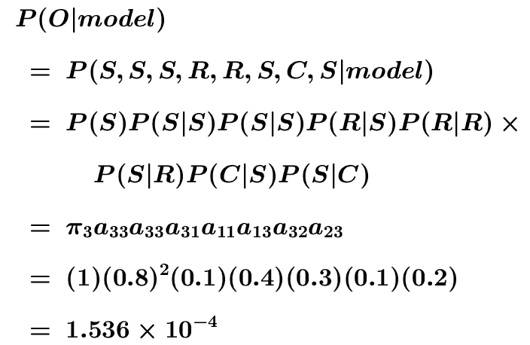
Weather Model
Observation Sequence O:
O = (S, S, S, R, R, S, C, S)
By Chain Rule

Slide 14
Hidden Markov Models
States are not observable
Observations are probabilistic functions of states
State transitions are still probabilistic

Slide 15
Coin Toss Models
Scenario: You are in a room with a barrier through which you cannot see that is happening. On the other side of barrier another person is performing a coin (or multiple coin) tossing experiment. He will only tell you the result of each coin flip.
The problem is how do we build a model to explain the observed sequence of heads and tails?

Slide 16

Coin Toss Models
Observation:a sequence of heads and tails
Build a HMM to explain the observed sequence
  What the states correspond to?
  How many states? (How many coins?)
  What are the parameters?

Slide 17


One-coin Model
observable 2-state Markov model: Each state corresponds to a side of the coin
It can also be modelled by a 1-state HMM, P(H) is the bias of the coin.
P(H)

Slide 18
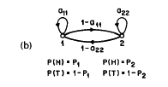

Two-coin Model
2-state Hidden Markov Model, where each state corresponds to a biased coin
Transition matrix are estimated by a set of independent coin tosses

Slide 19
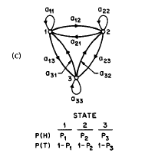

Three-coin Model
3-state Hidden Markov Model

Slide 20
Model Selection
Which model best matches the actual observations?
1-coin model: 1 unknown parameter
2-coin model: 4 unknown parameters
3-coin model: 9 unknown parameters
Larger HMMs may match better than smaller HMMs, but not neccessary so
Practical considerations impose strong limitation on the size of models

Slide 21
Urn Model 球瓮模型
There are several urns with colorful balls, and a blindfolded monkey chooses a urn and grabs a ball, and then gives it back. How many urns and colors can you guess from the results?
若干只瓮,每个瓮装彩球,多动的猴子被蒙住眼睛,选瓮摸球,给你看颜色,然后放回。已知若干个取球数据，问多少只瓮?多少种颜色的球?

Slide 22
Elements of a HMM
Q={1,2,…,N} : set of hidden states
V={1,2,…,M} : set of observation symbols
A: state transition probability matrix
  a_{ij} = P(q_{t+1}=j|q_{t}=i)
B: observation symbol probability
  b_{j}(k) = P(o_{t}=k|q_{t}=j)
π: initial state distribution
  π_{i} = P(q₁=i)
λ: the entire model λ=(A,B,π)

Slide 23
Sequence Generator
Given an HMM, how to generate a sequence of T observations? O=(o₁,o₂,…,o_{T})
Choose an initial state q₁ = S_{i} according to state distribution, and set t = 1
Choose O_{t}=v_{k} according to the symbol probability distribution in state S_{i}, i.e. b_{i}(k)
Transit to a new state q_{t+1}=S_{j} according to the state transition probability distribution for state S_{i}, i.e. a_{ij}
Set t = t+1; go to step 3 if t < T; otherwise terminate the procedure

Slide 24
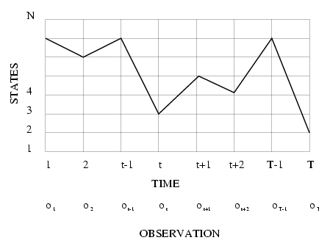
Execution of HMM
State sequence corresponds to a path in the grids

Slide 25
Three Basic Problems
compute the probability that the model generates the observation sequence
  model evaluation
find the optimal state sequence that generates the observation sequence
  hidden state discovery (tagging…)
learn an HMM that best fits the observation sequences
  HMM training

Slide 26
Basic Problem 1
Given observation O=(o₁,o₂,…,o_{T}) and model λ=(A,B,π), efficiently compute P(O|λ)
  P(O|λ) is the probability that O is produced by λ
  Hidden states complicates the probability evaluation
  Given two models λ₁ and λ₂, the probability (score) can be used to choose the better one
    λ_{i} models some protein family
    O denotes a protein
    find the most probable protein family for O

Slide 27
Basic Problem 2
Given observation O=(o₁,o₂,…,o_{T}) and model λ=(A,B,π), find the optimal state sequence q=(q₁,q₂,…,q_{T})
  to uncover the hidden part of the model; also called “decoding”
  Optimality criterion has to be decided (e.g. maximum likelihood)
  find “explanation” for the data
    O is the words
    find the POS tag of each word

Slide 28
Basic Problem 3
Given observation O=(o₁,o₂,…,o_{T}), estimate model parameters λ=(A,B,π) that maximizes P(O|λ)
  to train the model
  find the best parameters
  also called “learning”

Slide 29
Solution to Problem 1
Problem: compute P(o₁,o₂,…,o_{T}|λ)
Consider state sequence q=(q₁,q₂,…,q_{T})
P(O|λ) = Σ_{q} P(O|q,λ)P(q|λ)
  P(O|q,λ) = Π_{i=1,…,T}(o_{t}|q_{t},λ)
  = b_{q1}(o₁) b_{q2}(o₂)… b_{qT}(o_{T})
  Assume observations are independent of each other
  P(q|λ) = π_{q1}a_{q1q2}a_{q2q3}… a_{qT-1qT}
N^{T} state sequences each with O(T) time
  Complexity O(TN^{T})
  For N=5, T=100, TN^{T}=100x5¹⁰⁰ ~ 10⁷²

Slide 30
A better solution 优化解法
Dynamic programming ca be used to get P(O|λ) in linear time. 采用动态规划可以以线性复杂度来得到P(O|λ)

Slide 31

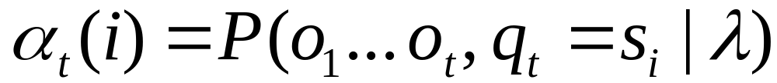
Forward Probabilities
What is the probability that, given an HMM , at time t the state is i and the partial observation o1 … ot has been generated?

Slide 32

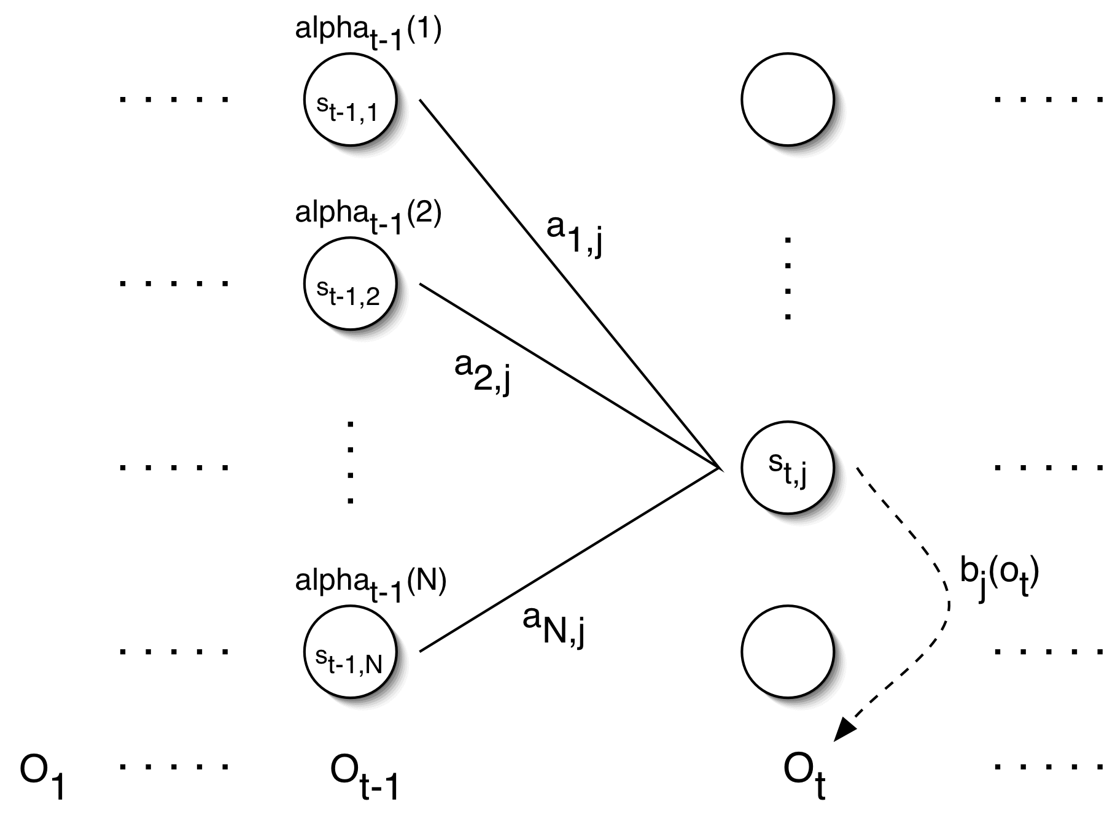
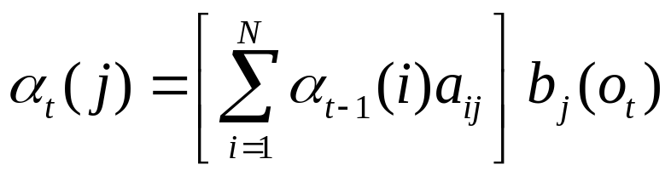
Forward Probabilities

Slide 33
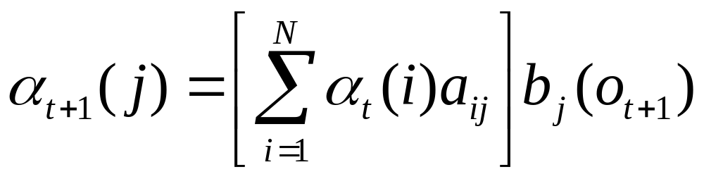
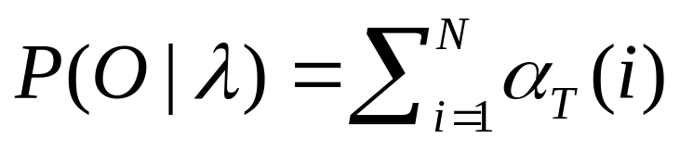
Forward Algorithm
forward variable α_{t}(i) = P(o₁,o₂,…,o_{t},q_{t}=i|λ)
α_{t}(i) is the probability of observing the partial sequence (o₁,o₂,…,o_{t}) such that state q_{t} is S_{i}
Initialization: α₁(i) = π_{i}b_{i}(o₁)
Induction:
Termination:
Complexity: O(N²T)

Slide 34
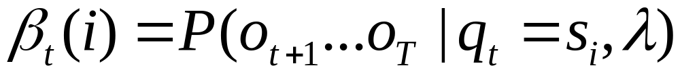
Backward Probabilities
Analogous to the forward probability, just in the other direction
What is the probability that given an HMM and given the state at time t is i, the partial observation o_{t+1} … o_{T} is generated?

Slide 35
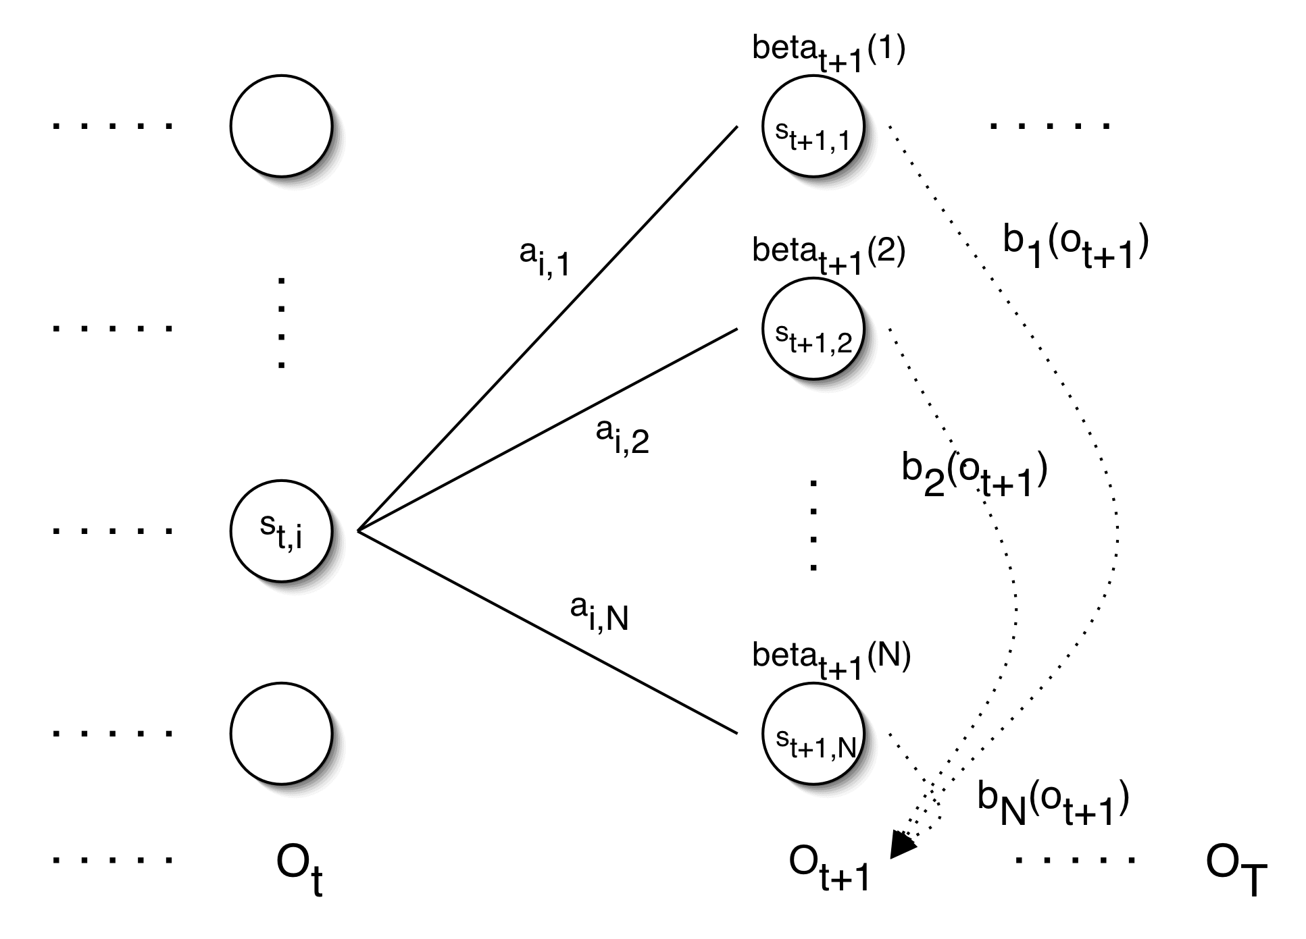
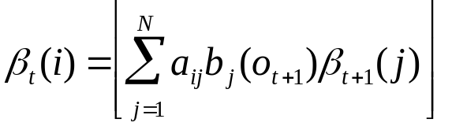
Backward Probabilities

Slide 36
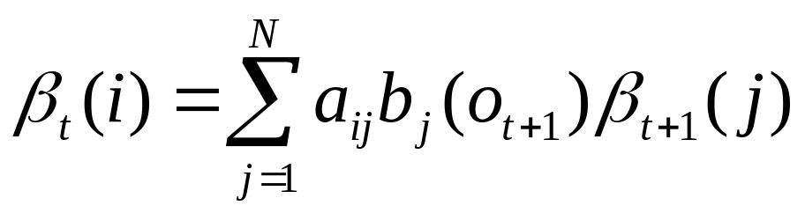
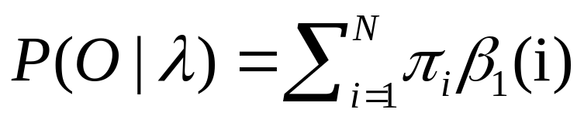
Backward Algorithm
backward variable
β_{t}(i) = P(o_{t+1},o_{t+2},…,o_{T}|q_{t}=i,λ)
β_{t}(i) is the probability of observing the partial sequence (o_{t+1},o_{t+2},…,o_{T}) such that state q_{t} is i
Initialization: β_{T}(i) = 1
Induction:
Termination:
Complexity: O(N²T)

Slide 37
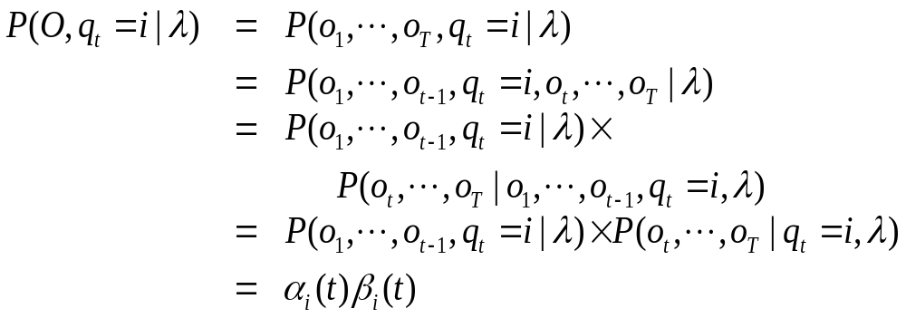
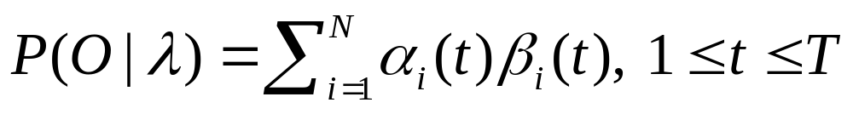
Combing Forward and Backward

Slide 38
Solution to Problem 2
Find the most likely path
Find the path that maximizes likelihood:
P(q₁,q₂,…,q_{T}|O,λ) which is equivalent to maximize P(q₁,q₂,…,q_{T},O|λ)
argmax q P(q|O, λ)
argmax q P(q, O|λ)/P(O|λ)
=argmax q P(q, O|λ)

Slide 39
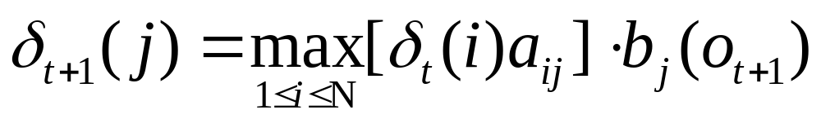
define
δ_{t}(i) is the highest prob. path ending at state i
by induction,

Slide 40
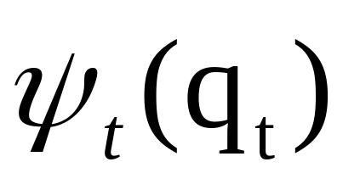
Viterbi Algorithm
The algorithm is similar to the forward algorithm, with operation Σ replaced by max. And the following function is added to remember the optimal path so far:

Slide 41




Viterbi Algorithm
Initialization:
Recursion:
Termination:
Path (state sequence) backtracking:

Slide 42

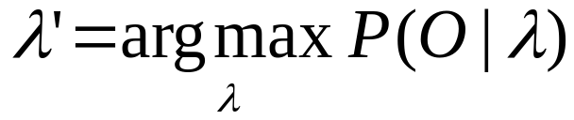

Solution to Problem 3
estimate λ=(A,B,π) to maximize P(O|λ)
Unfortunately, there is no known way to analytically find a global maximum, i.e., a model , such that
But it is possible to find a local maximum iteratively
Given an initial model λ , we can always find a model λ’, such that

Slide 43
Parameter Re-estimation
The algorithm is called the forward-backward (or Baum-Welch) algorithm
Using an initial parameter instantiation, the forward-backward algorithm iteratively re-estimates the parameters and improves the probability that given observations are generated by the new parameters

Slide 44

Parameter Re-estimation
Three parameters need to be re-estimated:
  Initial state distribution:
  Transition probabilities: a_{i,j}
  Emission probabilities: b_{i}(o_{t})

Slide 45
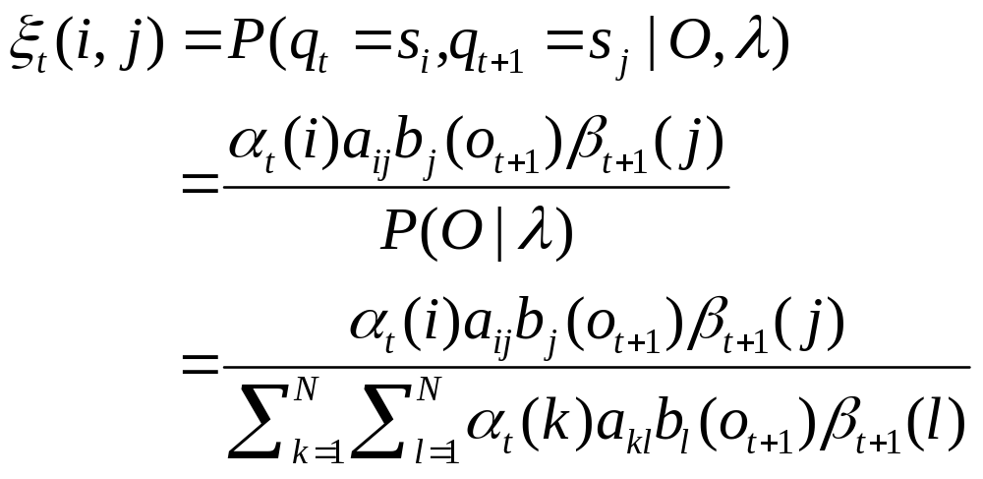
what is the probability of being in state i at time t, and in state j at time t+1?

Slide 46

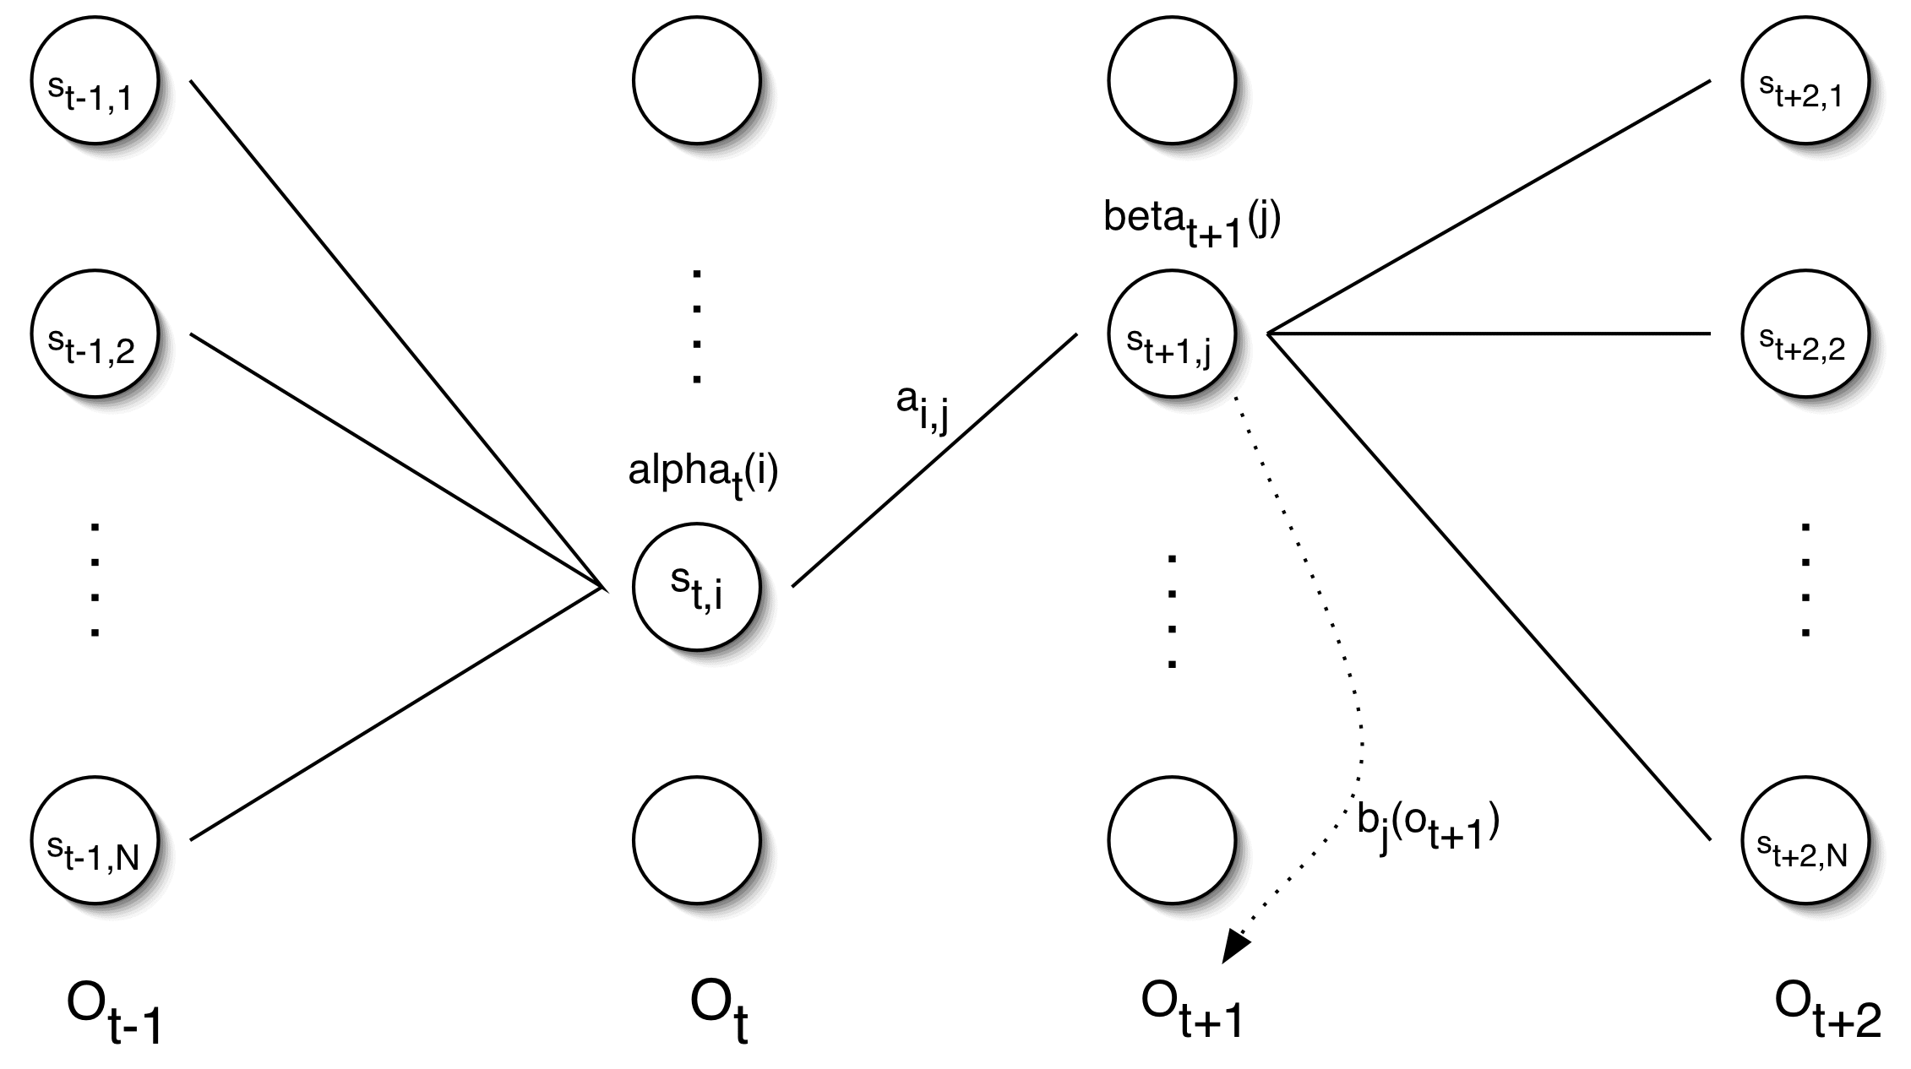
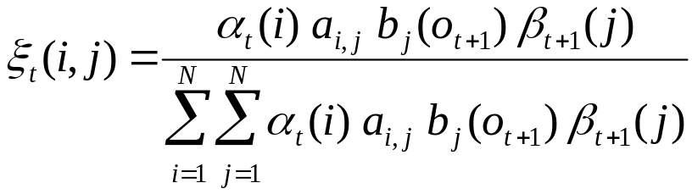
Re-estimating Transition Probabilities

Slide 47
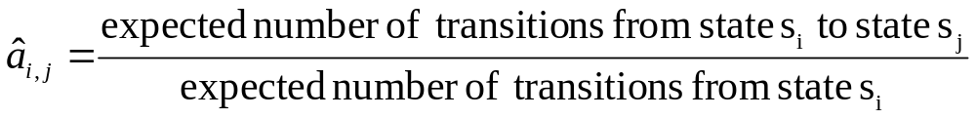
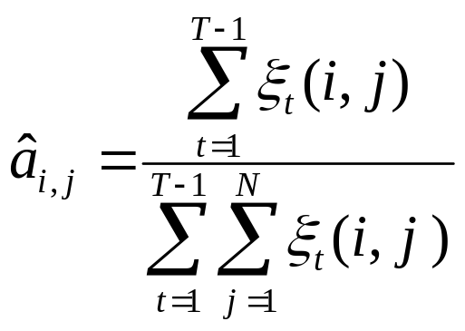
Re-estimating Transition Probabilities
The intuition behind the re-estimation equation for transition probabilities is
Formally:

Slide 48
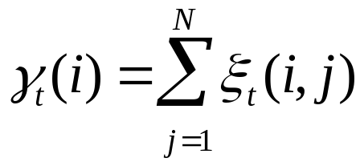
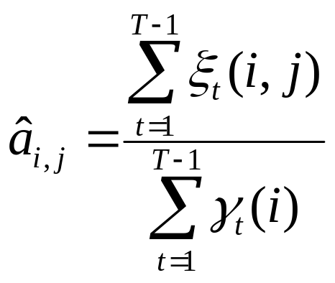
Re-estimating Transition Probabilities
Defining
As the probability of being in state s_{i}, given the complete observation O
We can say:

Slide 49
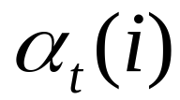


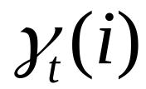
Review of Probabilities
Forward probability:
The probability of being in state s_{i}, given the partial observation o₁,…,o_{t}
Backward probability:
The probability of being in state s_{i}, given the partial observation o_{t+1},…,o_{T}
Transition probability:
The probability of going from state s_{i}, to state s_{j}, given the complete observation o₁,…,o_{T}
State probability:
The probability of being in state s_{i}, given the complete observation o₁,…,o_{T}

Slide 50

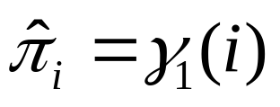
Re-estimating Initial State Probabilities
Initial state distribution: is the probability that s_{i} is a start state
Re-estimation is easy:
Formally:

Slide 51
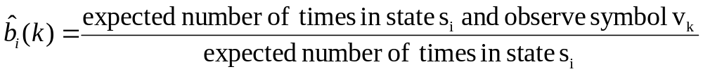
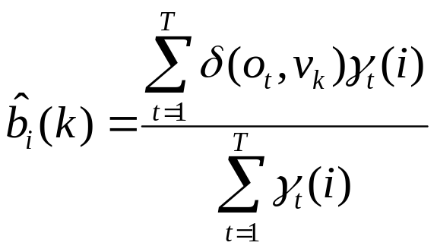

Re-estimation of Emission Probabilities
Emission probabilities are re-estimated as
Formally:
Where
Note that here is the Kronecker delta function and is not related to the in the discussion of the Viterbi algorithm!!

Slide 52

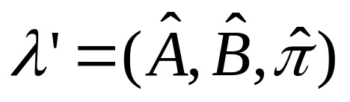
The Updated Model
Coming from we get to
by the following update rules:
P(O|λ’)>P(O|λ) 【refer to paper by Baum】

Slide 53
BW 算法概要
输入：观察序列的集合
初始化：起始概率，转移概率，发射概率
重复：
  对每个序列，求其alpha, beta，序列的概率, a(i,j)估计，b(i,k)估计
  重新归一化a(i,j), b(i,k) 为转移概率和发射概率
  直至整个序列集合的概率和不再变化

Slide 54
Expectation Maximization
The forward-backward algorithm is an instance of the more general EM algorithm
  The E Step: Compute the forward and backward probabilities for a give model
  The M Step: Re-estimate the model parameters

Slide 55
Simple way of HMM parameter estimation
If we have a tagged corpus with observations and states, we can compute transition and output probabilities by MLE (or with smoothing).
If the corpus is sufficiently large, then we may come up with a better model than trained by the Baum-Welch algorithm.
Small tagged and big untagged corpora can be used together to get an even better model.

Slide 56
HMM参数估计的简单办法
Baum-Welch算法只需要未标注的观察序列，不需要状态
假如我们有一个已经标注好观察值和状态序列的语料库,直接可以从该语料库计算出转移概率,输出概率,初始概率.
这样做的效果一般比Baum-Welch算法好
如果有标注语料和未标注语料，两者可以结合起来使用

Slide 57
Applications of HMM
Speech Recognition 语音识别
POS tagging 词性标注
Chinese input method
DNA Sequence Modeling
......

Slide 58
HMM Packages
SAM: http://www.cse.ucsc.edu/research/compbio/sam
HMMER: http://hmmer.wustl.edu/
use google to find more

Slide 59
homework
Read Rabiner’s HMM tutorial.
Download an HMM POS tagger for English and run it, e.g. https://github.com/jlipps/hmm-tagger

Slide 60
Projects课程设计
Design a input method editor for Chinese/Japanese/Tibetan/… based on HMM.
Design an HMM-based Spelling checker for Chinese pinyin (or other pronunciation-based input scheme).

Slide 61
Projects 课程设计
Rethinking of computer writing 计算机创作重新思考: sentences generated by n-gram models can contain syntactic errors, perhaps we can generate sentences from syntax patters (e.g. POS sequences)直接用n元模型产生句子显然难以保证产生的句子语法正确,可以考虑从句子的词性序列库产生.比如采用一个很好的词性标注器,得到莎士比亚的句型库,然后就可以按莎士比亚的风格创作了.唐诗宋词也如此.请你试一试.

